Slide 1
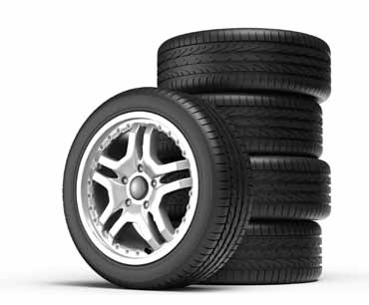
Soybean oil based products improve processing and performance in rubber compounds … along with environmental benefits.
The use of soy oil to make additives for rubber compounds is established in several uses:
• Vulcanized vegetable oil (including soy) as an extender and rubber substitute results in improved ozone resistance and improved flow properties.
• Epoxidized soy oil is used as a plasticizer / stabilizer in plastics and rubber.
Vulcanized vegetable oil (VVO), also known as factice, was originally developed as an extender and substitute material for more costly natural rubber. It can benefit ozone resistance, aging, and flow properties of rubber compounds. In natural rubber and styrene butadiene rubber compounds, soy-based VVO can delay of the onset of melt fracture, reduce extrudate swell, smooth extrudate surfaces, and improve dimensional stability.
Recent projects supported by the United Soybean Board have developed functionalized and higher molecular weight modifications of soy oil that provide significant property and processing improvements in rubber compounds.
In addition, a new development has found that by applying selected polymerization methods, thermoplastic elastomers can be made using soy oil.
Rubber Processing Oil
Soybean oil has the key attributes required of extender oils so it can be used in place of petroleum-based oils. Recent work has demonstrated that soy oil has chemical and physical compatibility with the rubber matrix and provides expanded options for low and high temperature properties. It can be used as a process oil and as a polymer extender. Improved mixing capabilities in the manufacturing process have been demonstrated, and rubber compounds made with soy oil blend more easily with the silica used in building tires. This can improve plant efficiency and reduce energy consumption and greenhouse gas emissions.
Bridgestone created a new agricultural tire for large, four-wheel drive tractors with eight tires. Soy oil constitutes more than 10 percent of the 900-pound tire. Developments are underway that could reduce the amount of petroleum-based oil used in tires
while simultaneously extending tread life. Tire tread compounds containing soy oil are being developed by a major tire producer for all-season and high-performance consumer products.

Slide 2
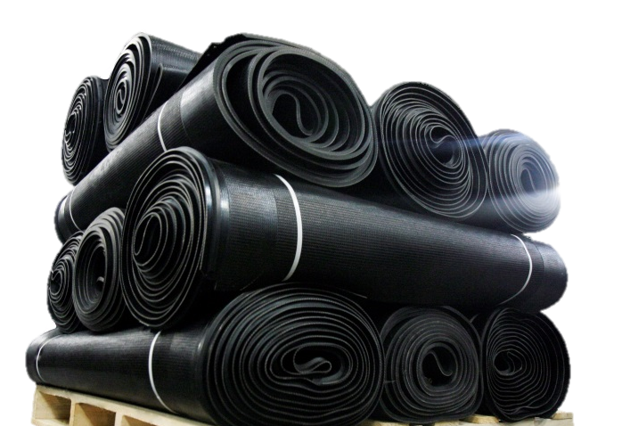
Abundant Sustainable Supply
U.S. farmers harvested 83.1 million acres of soybeans in 2014, yielding a record 3.97 billion bushels. U.S. soybean-oil production was 21.9 billion pounds. Crude conventional soybean oil is projected at 30 to 34 cents per pound, which is five cents lower than the 10-year average.
Soybeans are a global feedstock, grown in equal amounts in the Northern and Southern hemispheres. A new crop is planted and harvested twice each year, which helps moderate the potential for supply swings.
Since 2001, production of soybeans has increased by more than 40 percent. In the U.S., this growth has largely resulted from higher yields. Advances in agriculture ensure the rate of soybean production growth is sustainable and reliable.
Environmental Sustainability
Unlike fossil carbon sources, soybeans capture carbon dioxide from the atmosphere. Soybeans also fix their own nitrogen for plant food, which provides an advantage over other oilseeds that require nitrogen fertilizer.
In the U.S., a great percentage of soybean acreage uses conservation tillage, which disturbs the soil less and reduces fuel usage.
Product and Application Development is Underway
Soy oil has been functionalized to work as a reactive rubber processing oil. Compared to naphthenic oil, it provides better thermal stability and lower Tg for SBR and CR vulcanizates; better scorch safety and faster cure; higher elongation at break, tensile strength, abrasion resistance, and tear strength.
Higher molecular weight and chemically modified soy-based oils provide SBR-based rubbers with mechanical and thermal properties equivalent to those using a conventional petroleum-based processing oil with lower levels of extractables. Mechanical and thermal properties were increased with grafting.
Testing of soy oils in EPDM automotive applications showed samples passed initial and aged mechanical testing requirements. For an impact application, the soy-based rubber generally showed better material characteristics and energy dissipation capacity than the control.
WCCO Belting is a manufacturer of custom rubber belting solutions for the agricultural and light industrial markets. The RAPTOR® harvest header draper belting is used to harvest soybeans, wheat, canola, and more.
For more information on soy-based rubber compound and elastomers development and commercialization, contact
Robert Brentin, Omni Tech International,
rbrentin@omnitechintl.com.
It was the first product developed with soy oil rubber compound which has better resistance to abrasion. <Needs update from WCCO>

